Slide 1
Stationarity

Slide 2
Stationarity
Stationarity means that the statistical properties of a process generating a time series do not change over time.
The statistical properties are
Mean
Variance
Covariance
These remain same irrespective of the time at which you observe.

Slide 3
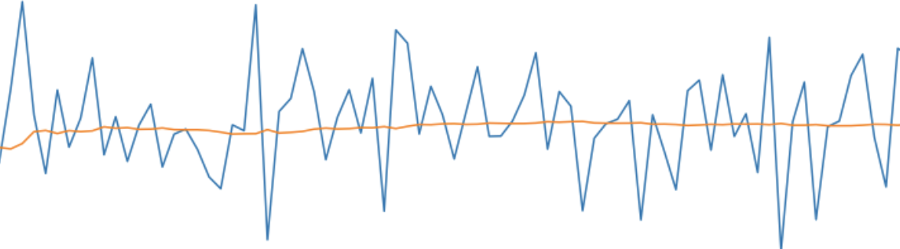
Time Series with Constant Mean
Here, the Blue line is the Time series and Red line is representing the “Mean”.

Slide 4
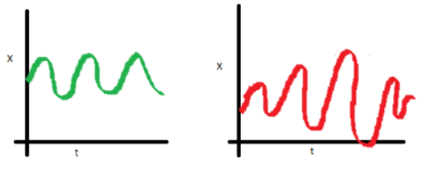
Time Series with Constant Variance and Covariance
Variance is the spread between the data points present within a time series data set.
The Green Line, Represents a Chart with Constant Variance.
The Red Line Represents a Chart with non constant variance.

Slide 5
Why Stationarity is important?
Stationary processes are easier to analyze and model because their statistical properties do not change over time.
If the statistical properties are not constant over time then it is said to be a Non-Stationary Time Series.

